Slide 1

Sleepy Owl Coffee
Audit & Strategize the Brand Marketing

Slide 2
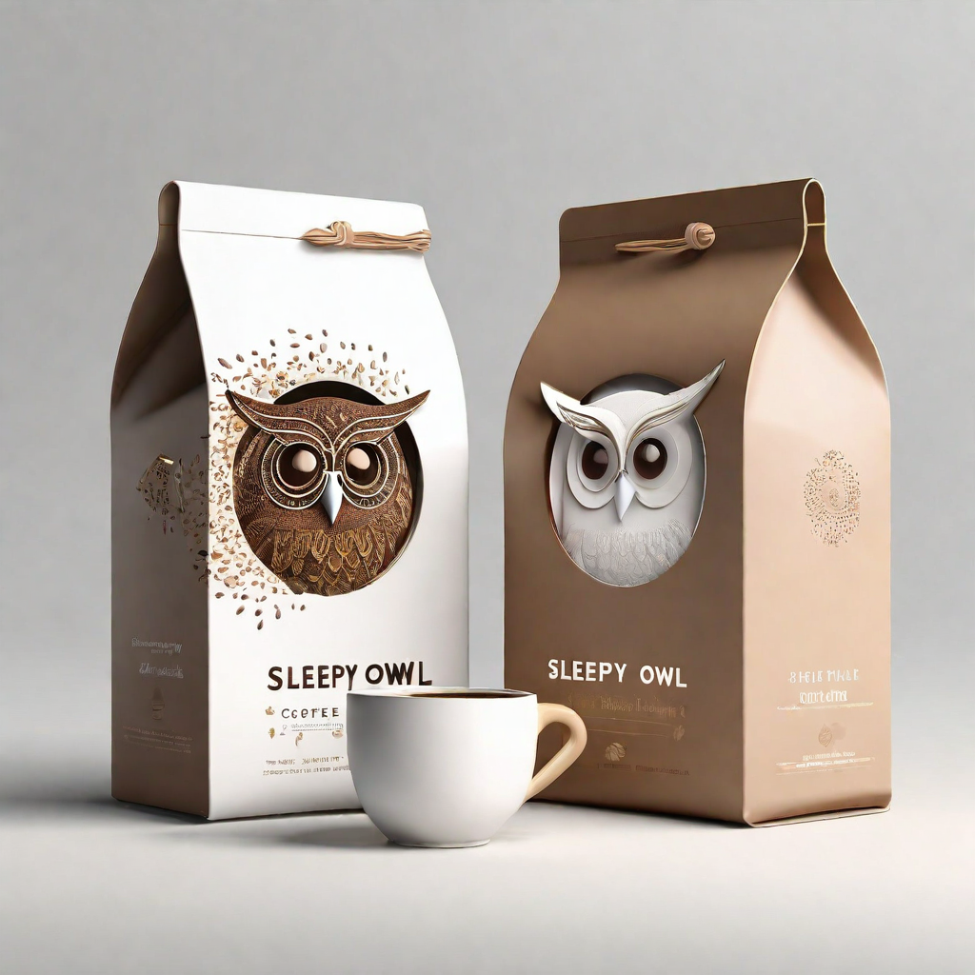
Brand Overview
Sleepy Owl Coffee was founded in 2016 by two friends with a mission to provide high-quality, specialty coffee to consumers in India. The brand started as a small-scale operation and has since grown to become a prominent player in the specialty coffee market.

Slide 3
Consumer & Brand Truth
➤ Commitment to High-Quality Coffee : Sleepy Owl Coffee ensures that every cup is made with carefully selected beans and expert craftsmanship.
➤ Sustainability Efforts : The brand is dedicated to sustainable sourcing practices and reducing its environmental impact.
➤ Values : Sleepy Owl Coffee is driven by a commitment to delivering the highest quality coffee to its customers.

Slide 4

Product or Service Offerings
➤ Sleepy Owl Coffee offers a wide range of hot & cold brew coffee products.
➤ The cold brew coffee is made from carefully selected beans and brewed slowly in cold water for a smooth and refreshing taste.
➤ They offer different flavors and strengths to cater to different preferences.
➤ Ready-to-drink bottles available in a variety of flavors and caffeine levels to suit different preferences.

Slide 5
Current Market Position
Brand Reputation : Sleepy Owl Coffee has built a positive brand reputation in the premium coffee market.
Loyal Customer Base : The brand has a strong and loyal customer base that appreciates the quality and taste of its products.
Target Market : Sleepy Owl Coffee products are well-received among urban millennials and coffee enthusiasts . Sleepy Owl targets the 24-30 year-old first-time coffee drinker who has just started earning and associating with brands.

Slide 6
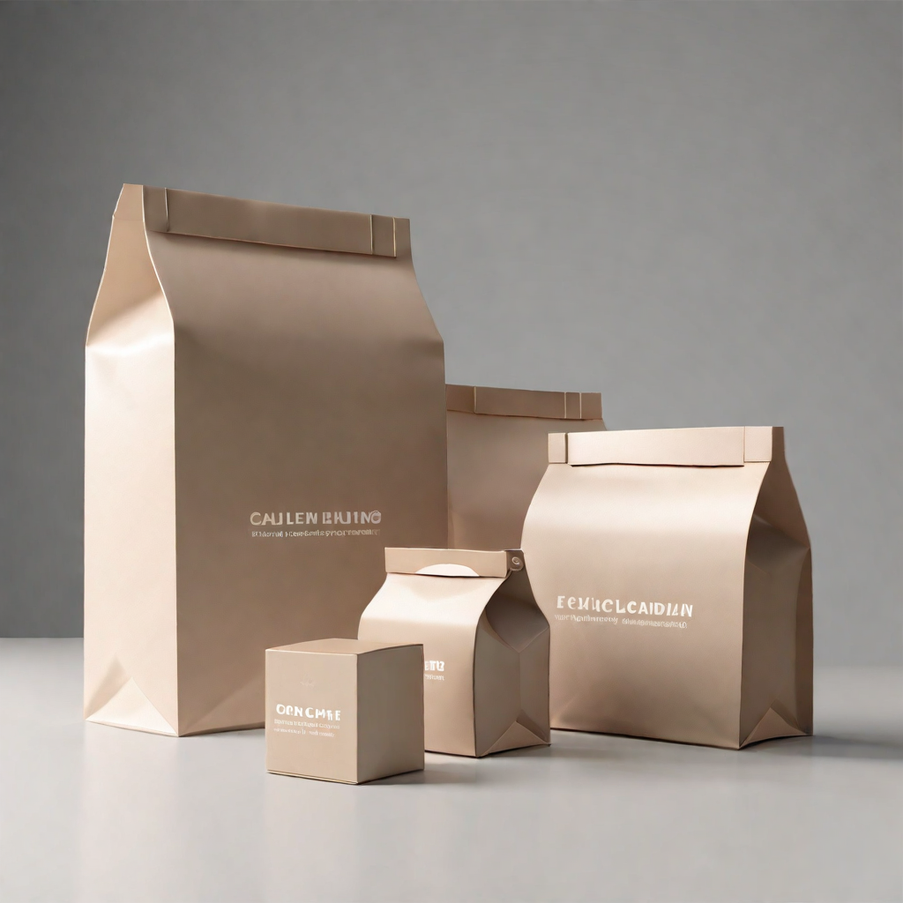
Recent Marketing Campaigns
Sleepy Owl recently launched a digital marketing campaign focused on promoting its eco-friendly packaging and commitment to sustainability. The campaign resonated well with environmentally conscious consumer base.

Slide 7
Competitive Research
Sleepy Owl Coffee operates in the specialty coffee market, which is highly competitive. Some major competitors in this field are
Blue Tokai Coffee Roasters: Known for its artisanal coffee beans and cozy cafes, They competes directly with Sleepy Owl in the premium coffee market .
Third Wave Coffee Roasters: Another player in the specialty coffee segment, They offers a diverse range of single-origin coffees and brewing equipment .
Starbucks: As a global coffee giant, Starbucks competes with Sleepy Owl in the ready-to-drink coffee segment, although targeting a broader audience.

Slide 8
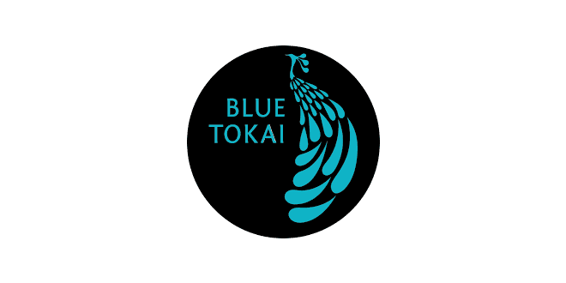
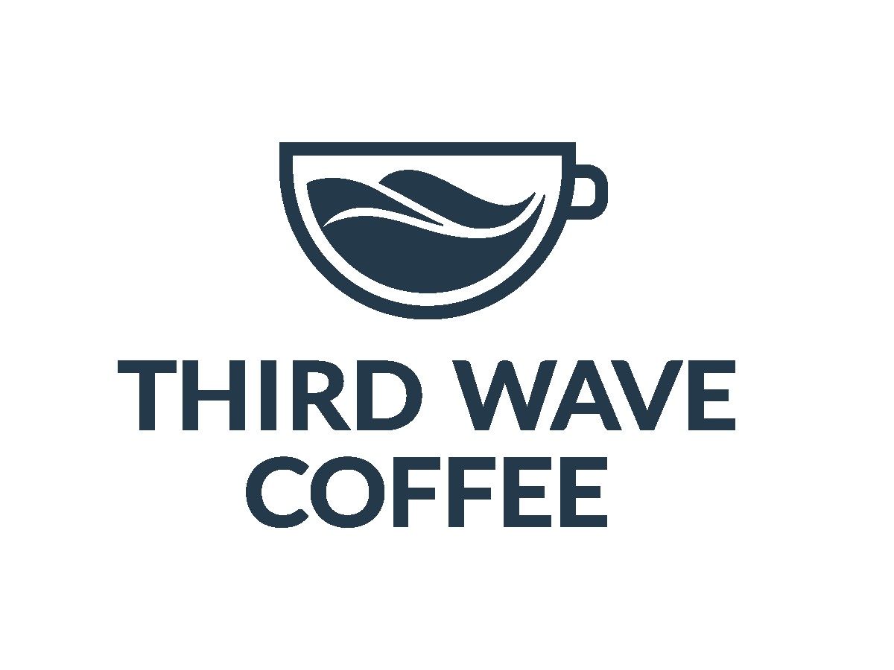
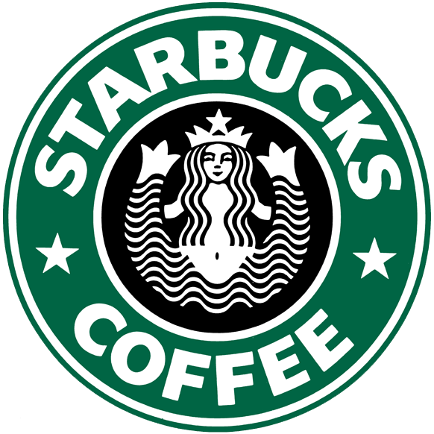
STRENGTHS & WEAKNESS
BRAND | STRENGTHS | WEAKNESS
Blue Tokai Coffee Roasters | Personalized coffee tastings and brewing workshops in its cafes Regularly introduces new and seasonal coffee blends | Premium pricing may deter budget-conscious consumers Mainly located in metropolitan cities,
Third Wave Coffee Roasters | Actively engages with its community through events, workshops, and collaborations, Offers a wide variety of single-origin coffees and brewing equipment, | Some consumers may perceive Third Wave's products as overpriced due to their premium positioning and emphasis on sustainability May struggle with brand awareness among mainstream consumers.
Starbucks | Vast network of stores worldwide, providing unparalleled accessibility Starbucks brand is synonymous with coffee culture and enjoys widespread recognition, attracting a broad customer base | Some consumers perceive Starbucks coffee as mass-produced and lacking the quality Premium pricing may deter markets with lower purchasing power

Slide 9
Target Audience of Competition
BRAND | DEMOGRAPHICS | PSYCHOGRAPHIC | BEHAVIORAL
Blue Tokai Coffee Roasters | Age : Urban professionals aged 25-45. Income : Middle to high-income earners with disposable income for premium coffee purchases. Location : Residents of metropolitan cities or urban areas with access to Blue Tokai cafes. | Busy professionals seeking a quality coffee experience as a part of their daily routine. Appreciation for craftsmanship, sustainability, and ethical sourcing. Interest in exploring diverse coffee flavors and brewing methods, as well as engaging in coffee-related events and workshops | Willing to pay a premium for high-quality coffee and value-added experiences. Likely to become repeat customers due to brand loyalty and positive experiences at Blue Tokai cafes. Influenced by peer recommendations and social media presence in their coffee choices.

Slide 10
Target Audience of Competition
BRAND | DEMOGRAPHICS | PSYCHOGRAPHIC | BEHAVIORAL
Third Wave Coffee Roasters | Age: Millennials and Generation Z consumers aged 18-35. Gender: Both male and female, Income: Moderate to high-income earners, willing to invest in specialty coffee experiences. Location: Residents of urban areas, cities with a vibrant coffee culture. | Health-conscious individuals with an interest in sustainability and ethical consumption. Emphasis on supporting local businesses, environmental responsibility, and community engagement. Passionate about coffee as a lifestyle choice, eager to explore different origins and brewing techniques . | Willing to experiment with new coffee offerings and pay a premium for high-quality, ethically sourced products. Actively participates in coffee-related events, workshops, and online communities. Values brands that prioritize sustainability and social impact, influencing purchase decisions accordingly.

Slide 11
Target Audience of Competition
BRAND | DEMOGRAPHICS | PSYCHOGRAPHIC | BEHAVIORAL
Starbucks | Age: Broad demographic appeal, targeting consumers aged 18-50. Gender: Both male and female. Income: Varied income levels, ranging from budget-conscious to affluent consumers. Location: Presence in urban, suburban, areas . | Lifestyle: Diverse lifestyles, including students, professionals, families, and tourists. Values: Convenience, social connection, and familiarity with the Starbucks brand. Interests: Seeking a consistent and convenient coffee experience, often as a part of their daily routine or social gatherings. | Regular patrons who value convenience and consistency in their coffee choices. Strong brand loyalty among repeat customers, driven by the Starbucks Rewards program and personalized offers. Coffee is consumed as a daily habit, social ritual, or on-the-go convenience, depending on the individual's lifestyle and preferences.

Slide 12
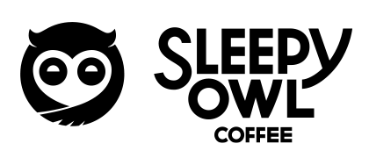
Brand vs Competition
BRAND | Unique Selling Propositions (USPs)
 | Focus on Cold Brew: Sleepy Owl specializes in cold brew coffee, offering a smoother, less acidic alternative to traditional hot coffee Eco-Friendly Packaging: Sleepy Owl uses environmentally friendly packaging materials. These practices resonates with environmentally conscious consumers who prioritize sustainability
 | Artisanal Coffee Beans: Blue Tokai prides itself on sourcing and roasting artisanal coffee beans from select regions. This differentiate it from mass-produced alternatives. Cafe Experience: Blue Tokai provides a curated cafe experience, allowing customers to enjoy freshly brewed coffee in a cozy and inviting ambiance. This welcoming environment fosters customer loyalty.
 | Community Engagement: Third Wave actively engages with its community through events,collaborations. the brand builds loyalty among customers who value meaningful interactions and shared experiences. Transparency: Third Wave provides its customers with information about the origin and quality of its coffee beans building trust .
 | Global Presence: Starbucks has a vast global presence in urban centers, airports, and retail locations, shopping malls providing unparalleled accessibility to customers in diverse locations . Product Innovation: Starbucks continuously innovates its menu with seasonal offerings, customization options. This keeps customers engaged and interested .

Slide 13
Competitive Advantage
Focus on Cold Brew: Sleepy Owl's Cold brew coffee has gained popularity due to its smoother, less acidic taste, making it appealing to a wide range of consumers, including those with sensitive stomach .
Convenience : Sleepy Owl's ready-to-drink cold brew bottles and DIY cold brew packs offer convenience and flexibility to consumers with busy lifestyles. Customer reviews frequently mention the convenience of Sleepy Owl's products, especially for on-the-go consumption .
Eco-Friendly Packaging: Positive market feedback often commends Sleepy Owl for its eco-friendly practices, contributing to its positive brand image and customer loyalty.

Slide 14

Identifying Existing Target Audience

Slide 15
Identifying Existing Target Audience
Demographic: The target audience consists of urban millennials and coffee enthusiasts . Sleepy Owl targets the 24-30 year-old first-time coffee drinker who has just started earning and associating with brands .
Psychographic: Sleepy Owl customers lead busy lifestyles, balancing work, studies, or other commitments. They appreciate convenience and seek products that fit seamlessly into their daily routines. Additionally, they value moments of relaxation and enjoy incorporating coffee breaks into their schedules .
Behavioral: Sleepy Owl's customers have regular and consistent consumption pattern, incorporating coffee into their daily routines. They are frequent purchasers of Sleepy Owl products, either through online orders or visits to cafes and retail outlets

Slide 16
Other Potential Target Audiences
Health-Conscious Consumers: Individuals who prioritize health and wellness may be attracted to Sleepy Owl's cold brew offerings, which are often perceived as a healthier alternative to traditional coffee due to their lower acidity . These consumers may value use of ethically sourced ingredients and eco-friendly packaging.
Professionals on Break: Employees from nearby offices or businesses who visit shopping malls during their lunch breaks or coffee breaks. These professionals may seek a refreshing pick-me-up from Sleepy Owl Coffee to help them recharge and stay focused throughout the day.

Slide 17
Creative Product Idea
There is a growing demand for affordable and convenient coffee solutions, especially among budget-conscious consumers or those who are new to specialty coffee. Introducing a Budget Mini Pouch Mix would align with this trend, offering a cost-effective option for consumers to enjoy Sleepy Owl's cold brew at home.
Despite being a budget-friendly option, the Budget Mini Pouch Mix would maintain Sleepy Owl's commitment to quality and taste. The mix would be made using the same high-quality, ethically sourced coffee beans and crafted with the same attention to detail as Sleepy Owl's premium offerings
By offering a Budget Mini Pouch Mix, Sleepy Owl demonstrates its willingness to adapt to needs of its customers. This fosters brand loyalty and trust, as consumers appreciate a brand provides solutions that meet their needs.

Slide 18

Target Group Strategy (STP)
New Target Group: Budget-Conscious Coffee Enthusiasts
Demographics: Primarily young adults aged 18 to 30, moderate income levels, urban and suburban dwellers.
Psychographics: Value-conscious consumers seeking affordability without compromising quality, appreciate simplicity and authenticity.
Behavioral Traits: Regular coffee drinkers, prioritize value for money, willing to try new brands for affordability.
Alignment with Brand Values: Sleepy Owl's commitment to quality and authenticity aligns with the needs of budget-conscious consumers seeking affordable yet premium coffee options .
Positioning Strategy: Position Sleepy Owl as the affordable luxury coffee brand, emphasizing quality without the premium price tag through targeted marketing campaigns, value bundle offers, and partnerships with budget-friendly retailers.

Slide 19
Anticipating Challenges, Impact, Solutions
1. Increased Competition: Competing brands may also target budget-conscious consumers, intensifying competition. This could lead to pricing pressures and reduced profit margins.
Solution: Focus on differentiation through unique value propositions, such as superior quality, sustainability, and brand authenticity, to stand out
2. Consumer Perception: Budget-conscious initiatives may unintentionally signal lower quality to consumers. This could erode brand equity and undermine Sleepy Owl's premium image.
Solution: Communicate the value proposition effectively, highlighting the brand's commitment to quality and sustainability, even within budget-friendly offerings through special marketing campaigns and storytelling personalized ads .

Slide 20

Anticipating Challenges, Impact, Solutions
Proactive Measures:
Leverage data analytics and consumer insights to optimize marketing ROI
Continuously monitor competitors' activities and adjust marketing strategies accordingly.
Engage with customers through feedback channels to gauge satisfaction with budget-conscious offerings and identify areas for improvement.
Invest in brand-building initiatives that reinforce Sleepy Owl's values and strengthen brand loyalty among both premium and budget-conscious consumers.

